Slide 1
Semi-Supervised Learning with Context-Conditional Generative Adversarial Networks
2016
Harsh Modi
Trupti Gore

Slide 2
Abstract : This research paper was produced by Emily Denton, Sam Gross and Rob Fergus. The team has trained images using semi-supervised learning approach based on in-painting using Adversarial Loss.
Emily is a PhD student at NYU while Sam and Rob are working with Facebook AI Research
Basic Understanding :
- Images with random patches removed are fed to the generator.
- The generator fills in the gaps (the missing patch) based on the surrounding pixels.
- These in-painted images are then fed to the discriminator network, which decides if the fed image is real or fake.

Slide 3
What is GANs?
GANs is a framework of training generative models. The generative and the discriminator network are made to compete each other in the quest to win over the other. The generator is trained to synthesize images resembling the data distribution, on the contrary the discriminator is trained to distinguish between the sample provided by the generator and the training data.
With every sample turned in, the generator produces images, which are close to the original image with the motive to fool the discriminator. And with every correctly identified fake image, the discriminator auto-tunes itself to become a better identifier between the fake and the real image.

Slide 4
# Challenges in using GAN and counter-measures to handle them :
GANs are known to be difficult to train. To train them better, there are some tricks(heuristics, not backed by theory) mentioned as below :
• We use tanh as the last activation function in our generator.
• For training deep learning model better, sparsity is introduced using Max Pooling and ReLU activations. Even though this is highly favourable for deep learning, it induces sparsity while training GANs and hence not used in training GANs. Downsampling being preferred in GANs, strided convolutions is used instead of max pooling and as well leaky ReLU is used since it allows small negative activation values reducing sparsity unlike ReLU.
• To avoid stagnancy in the network, we use dropout function in the discriminator and/or add random noise in the labels to discriminator to introduce randomness.

Slide 5
What is a Context Conditional Generative Adversarial Network ?
CC-GANs are conditional GANs and they work as below :
1. The generator and discriminator are trained with labelled data while training and qualify as ‘Real Image’
2. These images, however with a missing patch is then fed as input to the generator.
3. The generator produces a complete in-paint image with the missing patch filled conditioned on the surrounding pixels.
4. Further this complete image is fed to the discriminator, for it to identify the real and the fake image.

Slide 6
Train GAN Model using STL-10 dataset
Dataset used : STL-10
Information about the dataset used : This dataset is an image recognition dataset for deep learning of high resolution (96x96)
Overview :
10 classes : airplane, bird, car, cat, dog, deer, horse, monkey, ship, truck
500 training images(10 pre-defined folds), 800 test images per class
100000 unlabelled images for unsupervised learning. Images acquired from ImageNet.
Data download : Data is downloaded and extracted locally from the ai.standford.edu website. Images and labels are stored in separate paths. Images are forcibly read in the 96x96 image matrix in the rgb channel. We also transpose the images since we are looking to reduce sparsity consumed by the 3 channels(rgb), this is unlikely if the modelling algorithm is a CNN based algorithm.

Slide 7
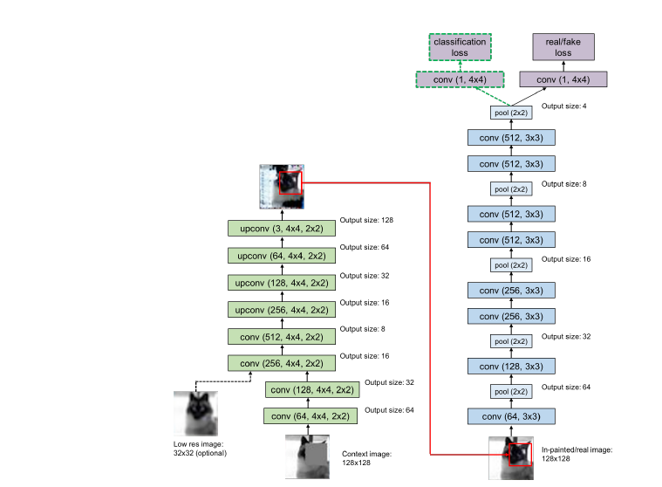
Architecture of the CC-GAN :

Slide 8
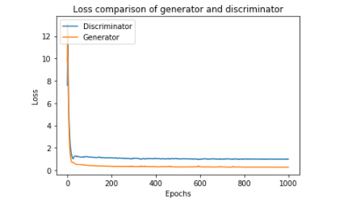
Discriminator Loss Vs. Generator Loss
Supervised Training Data

Slide 9
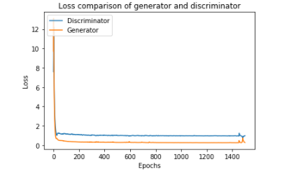
Semi-Supervised Example
Discriminator Loss Vs. Generator Loss

Slide 10
Thank you
Reference : https://github.com/edenton/cc-gan

